Slide 1
Introduction to React and Redux
[ Instructor Name ]
[ Instructor E-mail ]

Slide 2

React
JavaScript library for building UIs
Focus is on code, not templates
The V in MVC
React Components are composable
One-way reactive data flow
Two-way data binding is supported, but is not the default
Handles DOM manipulations efficiently using a virtual DOM
Notes:
React was created by Facebook. It is open-source and lives on GitHub at https://facebook.github.io/react/.
React is NOT a framework. It does not:
Manage application state
Manage asynchronous operations
Process business logic
Provide a controller, routing or other such similar features
Provides local storage mechanisms
Provides a mechanism for services and dependency injection
React is it is for coding UI elements.

Slide 3
ES2017, ES2016, ES2015…
Typically, React development is done with the latest and greatest JavaScript features
Support for these cutting-edge features, especially when running React applications in older browsers, is provided by a transpiler such as Babel or TypeScript
Because JSX, a little language which simplifies the development of components, requires a transpiler, it makes sense to use the transpiler for the whole application to gain access to the latest JavaScript features such as ES2015 modules, arrow functions, classes, etc…

Slide 4
ES2017, ES2016, ES2015…
While Babel is very popular (and used in this class), the TypeScript transpiler provides the same benefits plus strong-typing
Transpilers have become an essential part of the development tool chain in modern JavaScript development
Annually, new JavaScript features are released
Usually, before a new feature is released, transpiler support for the feature provides a mean to use it in an older browser, even before the new feature is a standard

Slide 5
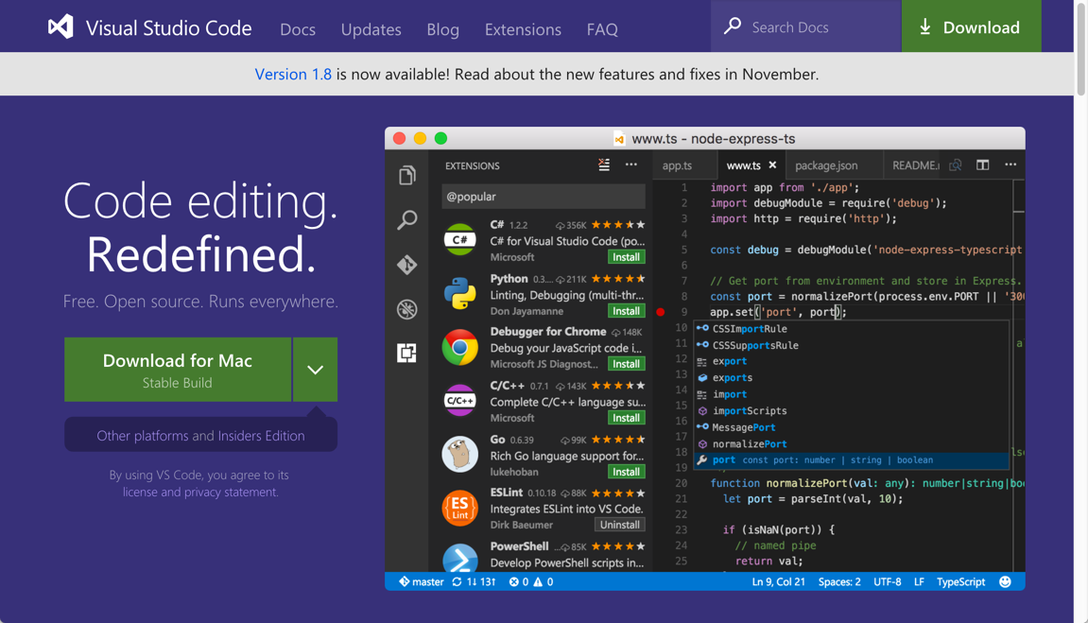
Visual Studio Code
Visual Studio Code is among the most popular editors for coding JavaScript applications
Simply referred to as Code, it provides out-of-the-box support for JSX
Code itself is an Electron-based editor coded with Chromium and Node.js using HTML/CSS/JavaScript
Code is an open-source project
http://code.visualstudio.com (runs on Windows, MacOS & Linux)

Slide 6
Node.js and NPM
Node.js is server-side JavaScript
Node.js and its package manager, NPM, are used to manage the JavaScript packages needed for the development tool chain including React itself
React and the application's JavaScript files are bundled with a tool named Webpack 2
When bundling the files, Webpack 2 runs the files though specially configured loaders such as Babel to transpile the code
Webpack 2 also provides the web development server

Slide 7
Node.js and NPM
REST Services are provided by the JSON Server
Webpack 2 and JSON Server are both built with Node.js and distributed via NPM

Slide 8
Exploring JSX
When a JSX element is transpiled, the result is a createElement call in the outputted code
JSX elements are not HTML and they are not string content, the elements are nested function calls
JSX looks like HTML, which allows the developer to think of the UI structure as a traditional HTML markup structure, but under the hood the elements are only function calls
JSX | <h1 id="page-header">App Tool</h1>
JavaScript | React.createElement('h1', { id: 'page-header' }, 'App Tool')

Slide 9
ES2015 Modules
Originally, JavaScript did not support the usual structures for building large applications such as namespaces or modules
Over the course of time, several patterns emerged for organizing applications into modules: AMD (asynchronous module definition) and CommonJS
Most developers know of AMD through one of its popular implementations Require.js; and CommonJS is used by Node.js
While both module systems are still used today, the JavaScript specification (ES2015) now has support for modules which will be referred to as ES2015 Modules

Slide 10
ES2015 Modules
Through the use of Babel and Webpack 2, ES2015 Modules are available to developers
When React is installed in the application via NPM, it can be easily imported using the import syntax of ES2015 modules
An application grows with numerous component and other classes, each class receives its own file, and can be imported by other files if the class is marked with the export keyword

Slide 11
Fetch API
To retrieve data from REST services, the fetch API will be used
The fetch API is a replacement for the XMLHttpRequest (XHR) object
The fetch API makes no assumptions about the data transfer format
The fetch API is not an official standard yet, but it is supported by many modern browsers, and a polyfill is loaded in our project to make the API available in older browsers
The Webpack 2 configuration for the lab project makes a fetch polyfill available for browsers which do not support it natively

Slide 12
React Component Data
React Component data is one of the most important aspects of working with React
Components utilize three kinds of data: props, state and context
Props, state and context indicate the relationship of the component to a particular data

Slide 13
React Component Data
Props represent data passed from the application or a parent component, and within the component receiving the data, the data is considered immutable
State represents data local to a component, and mutable only within that component, but the component may pass the data as props to a child component
Therefore, data which is state in a parent component, may be props in a child component
It’s the same data in both places, but each component's relationship to the data is different: the parent component can mutate, and child component cannot mutate

Slide 14
React Component Data
Component
State is local to each component. State can only be directly referenced and mutated from within the component to which it belongs
Props data originates from outside the component tree from the application
state
props
render
props
Component
state
context
Context can be thought of as a global scope within the component tree, its use should be limited
Props + State may be passed in as Props to a child component, data which is state in one component, can be be props in the child component
render
props
Component
state
render

Slide 15
Composing React Components
In addition to managing component data, the other critical concept of working with components is how to compose them
While a single React component can contain the entire UI, this is not a best practice
Instead, large UIs should be decomposed into many smaller components, which are then composed together to form a larger UI
The flow of data between parent and child components is critical:
Parent passes data to child component via props; data is immutable to child
Child passes data to parent via events; data is used to update the state of the parent, or is passed up the component tree

Slide 16

Composing React Components
This is the most important concept of Component Driven Development as it
applies to all modern component based frameworks/libraries such as React
Parent Component
Input Properties
Output Events
Input Properties are typically data values and event handler. The child component receives the parent data input, and uses the parent event handlers to communicate data to the parent
Events from within the child invoke the event handlers from the parent. The child passes data to the parent through arguments passed to the event handler when invoked
Child Component

Slide 17

Redux
JavaScript library for managing state
Views execution of an app as initial state followed by a series of actions
Each action reduces state to a new predictable state
A state container, known as a store, contains reduction logic implemented as pure functions as well as the current state
Notes:
Redux is open-source and lives at http://redux.js.org/. Ot is frequently paired with React, but works with other JavaScript libraries as well.

Slide 18
Three Principles of Redux
To enable state changes to be predictable, the following constraints applied to state changes
Single Source of Truth
State is Read-Only
Changes are made with Pure Functions

Slide 19
Single Source of Truth
Following the pattern of Flux, all data flows through a Redux system in a unidirectional matter
All changes to the state comes from actions applied to the state, and all actions are funneled into Redux
No part of the system can ever receive data from two sources
Additionally, the state managed by Redux is the state of the whole application (with minor exceptions, such as form control entry)

Slide 20
State is Read-Only
State can never be mutated
New states are produced by applying an action to the current state (known as reduction) from which a new state object is produced
Immutable programming techniques need to be utilized

Slide 21
Changes are made with Pure Functions
Pure functions accept inputs, and using only those inputs produce a single output
Do not modify the input parameters
The function produces no side effects
The only output is what is returned from the function
Many pure functions can be composed together to process different parts of the state tree

Slide 22
Definition of Redux
From the Redux website, "Redux is a predictable state container for JavaScript apps."
Predictable – state changes follow the three principles
State – the application's data, including data related to the UI itself
Container – Redux is the container which applies actions to the pure reducer functions to return a new state
Redux has been designed for JavaScript applications

Slide 23
Differences from Flux
While Redux and Flux share similar concepts and principles, there are some differences
Flux differentiates between the dispatcher and store, this is because Flux supports multiple stores
Redux limits the application to one store which means the store and dispatcher can be combined into one dispatcher-store

Slide 24
Reducer Functions
Follows the pattern of the reduce function available on the Array prototype in JavaScript
Receives the current state and an action, the function produces a new state based upon the type of action, and its associated data
Pure function – output results from inputs only, no side-effects
Should be configured to create an initial state during the first run

Slide 25
Working with Stores
Stores are the container for applying the action to the state using the reducer function, and they contain the current state
Created with the createStore function
The first parameter is the reducer function
The second parameter is an optional initial state, if this is not provided the default state initialized by the reducer function will be used on the first run-through

Slide 26
Handling Actions with the Store
Actions are sent to the store using the dispatch function
The dispatch function accepts the action object as an argument
The action object must have a type property to identify what the action is, additional properties with other relevant data may be specified as well

Slide 27
Distributing the New State
To distribute the new state produced from a dispatched action, a publisher/subscriber model is used through a subscribe function available on the store
When actions are dispatched, they are processed by the reducer producing a new state, then all of the subscriber functions are invoked so they can process the new state
The new state is retrieved in the subscriber function through the getState function on the store

Slide 28
Integration with React and Asynchronous Programming
Redux works great with React, but Redux is not limited to only working React
Nevertheless, the React/Redux combination is so popular there are special libraries for tying the two together and there are lots of resources online which explore this common combination of libraries
Asynchronous programming introduces additional complexities to managing state

Slide 29
Integration with React
Because of React's notion of state versus props, and Redux's approach to application state and the changing of it, React and Redux work together in a very natural, easy, and powerful way
Redux is used to manage the application's state, not each component's state
The application's state and action creator functions are passed as props to presentational components through container components
The presentational components invoke the action creator functions triggering the Redux store to update the application state and propagate the new state through the container components to the presentational components

Slide 30
Presentational versus Container Components Connecting State and Components without a Container
The presentational component requires knowledge of the store and how to dispatch actions. This tightly couples the presentational component to the application environment. Because of this coupling, the presentational components cannot be easily reused.
Actions
dispatch
Application State Store
(Redux)
Presentational Component
(React)
getState

Slide 31
Presentational versus Container Components Connecting State and Components with a Container
Actions
dispatch
The presentational component no longer requires knowledge of the store or how to dispatch actions. The container component will map the application state and actions to the presentational component props. This allows the presentational component to be loosely coupled the application environment, and makes it more reusable.
Container Component
Application State Store
(Redux)
getState
Presentational Component
(React)

Slide 32
Connecting React to Redux Wrapping a presentational component
The react-redux package provides helper functions to wrap presentational components with programmatically-created container components which are connected to the application's Redux store
The connect function provides the wrapping mechanism, but requires mappings between the Redux store and the presentational component's props
Maps the application state to the wrapped presentational component's props
Configures the actions that will be available in the component tree, and how to dispatch them to the store

